Slide 1

Underlay Device-to-Device Communication
Submitted By
SRIPADA SRIKAR - AP19110010474
SOUVIK MANDAL - AP19110010485
RUDRARAJU NITIN VARMA - AP19110010336
DANDU GIREESWAR VARMA - AP19110010557

Slide 2
Introduction
INTRODUCTION
Increasing demand for broadband mobile wireless communications
High growth rate of wireless communication and data traffic
Subscriber base increase exponentially etc.
Device-to-device (D2D) communications
It is a promising technique for offloading local traffic from cellular base stations by allowing local devices, in physical proximity, to communicate directly with each other.
Through relaying, D2D is also a promising approach to enhancing service coverage at cell edges or in black spots..
Open up opportunities for new proximity-based services and applications

Slide 3
Central Idea
Exploiting the natural proximity of communicating devices may provide multiple performance benefits.
D2D user equipment (UE) may enjoy high data rates and low end-to-end delay due to the short-range direct communication.
It is more resource-efficient for proximate UE devices to communicate directly with each other than routing through an evolved Node B (eNB) and possibly the core network. compared to normal downlink/uplink cellular communication, direct communication saves energy and improves radio resource utilization.
Switching from an infrastructure path to a direct path offloads cellular traffic, alleviating congestion, and thus benefitting other non-D2D UE as well.

Slide 4
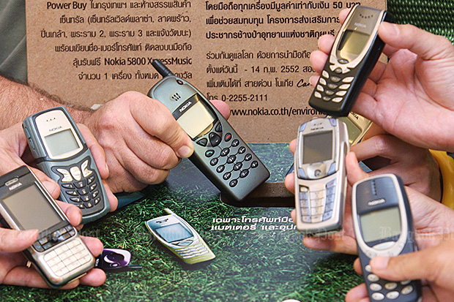
Introduction

Slide 5
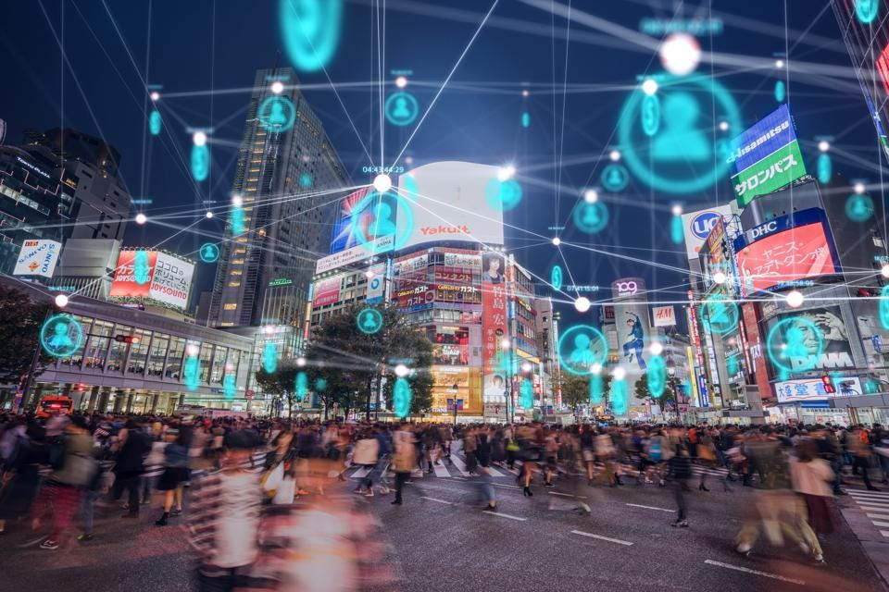
Introduction

Slide 6
Why D2D Communications?
5G Perspective: Common View
Challenges
High connection density
High date rate
High traffic volume
High mobility
Low latency
Design principles
Spectrum efficiency
Energy efficiency
Cost efficiency

Slide 7
Why D2D Communications?
Advantages of D2D Communications
Proximity gain
Hop gain
Reuse gain
Potential Benefits
Higher data rate /capacity
Lower latency
Higher spectrum-, energy-, and cost-efficiency
Better robustness

Slide 8
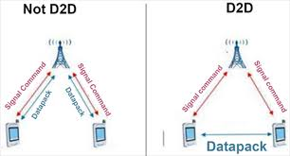
Big Question
Is it possible for UEs in proximity to communicate among themselves?

Slide 9
Growth of Networks
Challenges for future wireless communication-
Massive growth in connected devices
Smart phones, laptops, sensor devices, etc
Massive growth on network traffic
Almost 1000+ times or more
61% CAGR expected
Wide range of applications and their requirements
Social media, video on demand, live TVs, gaming, loT, etc

Slide 10
Can we match to the growth?
Increasing Access Capacity...
Add more BTS(Base Transceiver System)
•At present we have 7,36,654 BTS in India
•Tata Teleservices alone has 3000+ BTS in Bangalore
•New BTS will add CAPEX and OPEX
Release new spectrum
•Huge cost for the operators
•Seems to be a challenge
Only 200+ MHz available in India
Improve the spectral efficiency
•Not possible always
Theoretical Limits are being reached
•Usability is the key
Yet to deploy LTE Rel8
Spectral efficiency 4-5
Increasing Backhaul Capacity
*Nationwide optical fiber backbone
*Only a few operators can do this
•CAPEX and OPEX issue again

Slide 11
Challenges in D2D
Communication Challenges
Location of the devices
Ensure accuracy
Signaling techniques need to be amended
Signaling overhead to be evaluated
New Modulation Schemes can be proposed
Cellular: SC-FDMA Tx (UE-eNB) and OFDMA Rx (eNB-UE)
D2D: SC-FDMA receiver in UE (UE-UE)
Interference Management
To ensure interference below threshold in case of overlapping D2D
Power control model
Select the transmit power depending on distance/channel characteristics
Channel model
Short distance (indoor/outdoor) channel model can be explored
D2D traffic characterization
What percentage of the users are D2D?

Slide 12
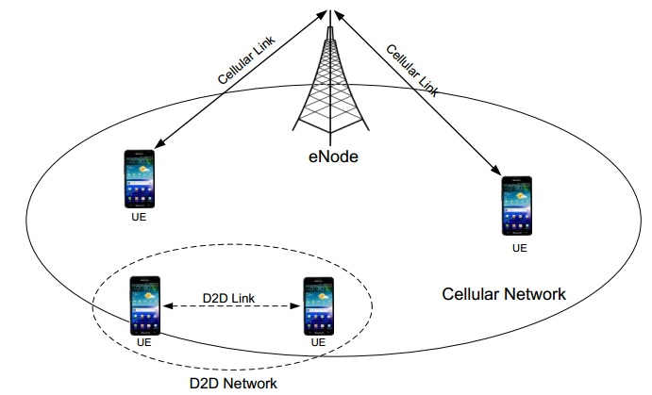
Definition and Benefits
Extend coverage
Increase network capacity
Offload data
Improve energy efficiency
Create new applications

Slide 13
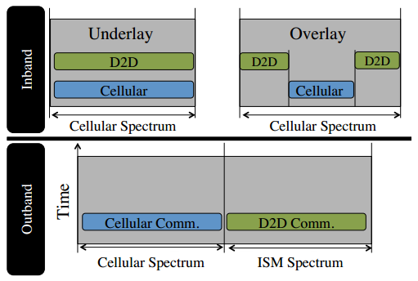
D2D bandwidth spectrum
Asadi, Arash, Qing Wang, and Vincenzo Mancuso. "A survey on device-to-device communication in cellular networks." IEEE Communications Surveys & Tutorials 16, no. 4 (2014): 1801-1819.

Slide 14
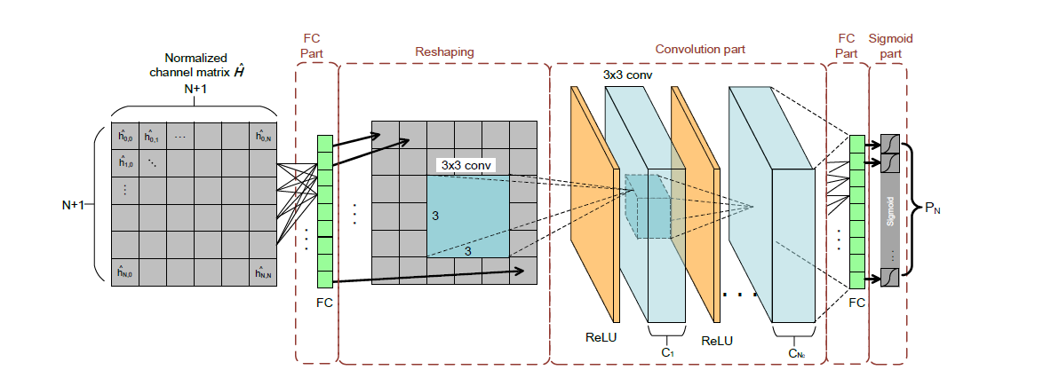
Problem Formulation
Lee, Woongsup, Minhoe Kim, and Dong-Ho Cho. "Transmit power control using deep neural network for underlay device-to-device communication." IEEE Wireless Communications Letters 8, no. 1 (2018): 141-144.

Slide 15
Problem Formulation
The proposed model consists of 2 FC ‘s, a convolution part along with ReLu layer between 2 FC’s then, a sigmoid Part at the end of 2nd FC.
The Normalized Channel Gain is given as input to the 1st FC where the FC find the optimal fusion strategy .
Convolution part extracts Spatial features used for transmit power and pass it to ReLu layer.
ReLu layer normalizes the output.
The Role of the 2nd FC is to integrate the output from convolution part.
The Sigmoid part is used to normalize the output from 2nd FC.

Slide 16

Problem Formulation
Spectral Efficiency hereby is calculated as follows:
Here h_{ii} indicates the channel gain between the transmitter of TP and receiver of TP.
P indicates transmit power of DUE TP
W and N₀ indicates bandwidth and noise spectral density
P_{Mc} indicates the transmit power of CUE TP.

Slide 17
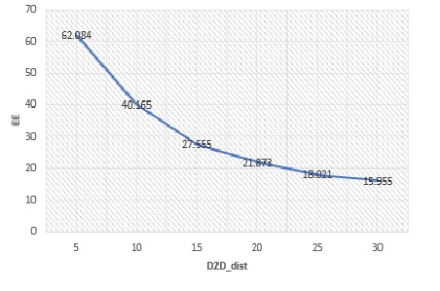
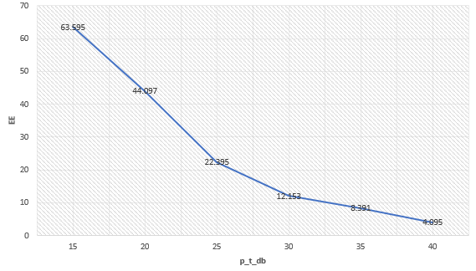
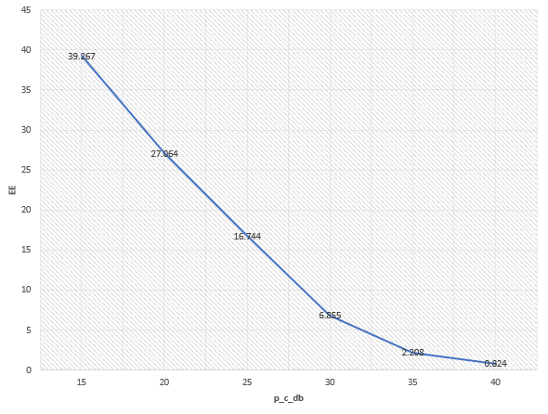
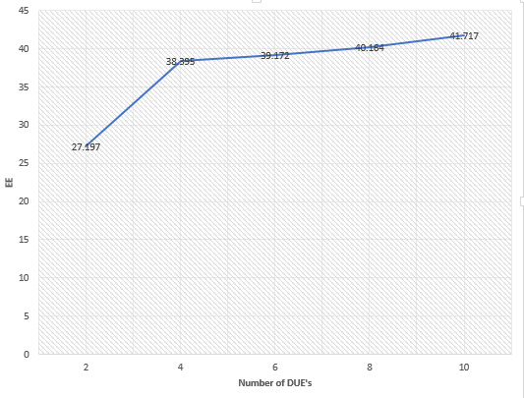
Results

Slide 18
Conclusion
The proposed DNN structure is investigated and trained autonomously to obtain the Transmit power.
A Trade-off between the SE of DUE and Interference caused at CUE (I_{CUE}) is achieved.
Low Computational time.

Slide 19
Future Works
Full-Duplex D2D Communications
Unlicensed- Band D2D Communications
D2D-Aissitend Small Cell Deployment
Cooperative D2D Caching

Slide 20
References
Cisco, "Visual networking index," white paper at Cisco.com, 2014.
B. Bangerter. (2014) Intel. Communications Magazine. 90-96.
Celik, Aslihan, Jessica Tetzner, Koushik Sinha, and John Matta. “5G device-to-device communication security and multipath routing solutions.” Applied Network Science 4, no. 1 (2019): 1-24.
Jee Hyeong Kim, Joohan Park, Jaewon Noh, Sunghyun Cho, “Autonomous Power Allocation based on Distributed Deep Learning for Device-to-Device Communication Underlaying Cellular Network”. IEEE Access (2020): 107853-107864.
Hung, Shao-Chou, Hsiang Hsu, Shao-Yu Lien, and Kwang-Cheng Chen. "Architecture harmonization between cloud radio access networks and fog networks." IEEE Access 3 (2015): 3019-3034.
Trung-Dinh Han,"Device-To-Device (D2D) communication in 5G cellular networks." IEEE Access (2015): 2090-4886.
Mohsen Nader Tehrani, Murat Uysal, Halim Yanikomeroglu. "Device-to-Device Communication in 5G Cellular Networks: Challenges, Solutions, and Future Directions." IEEE Access (2021): 86-92.
Sanjay Kumar Biswash, Artur Ziviani, Raj Jain, Jia-Chin Lin, Joel J. P. C. Rodrigues. "Device-to-Device Communication in 5G Networks." IEEE Access (2017): 995–997.
Zexian Li, Fernando Sanchez Moya, Fodor Gabor, Jose Mairton B. da Silva, Jr. Konstantinos Koufos. "5 - Device-to-device (D2D) communications." (2016): 107-136.

Slide 21


